Slide 1
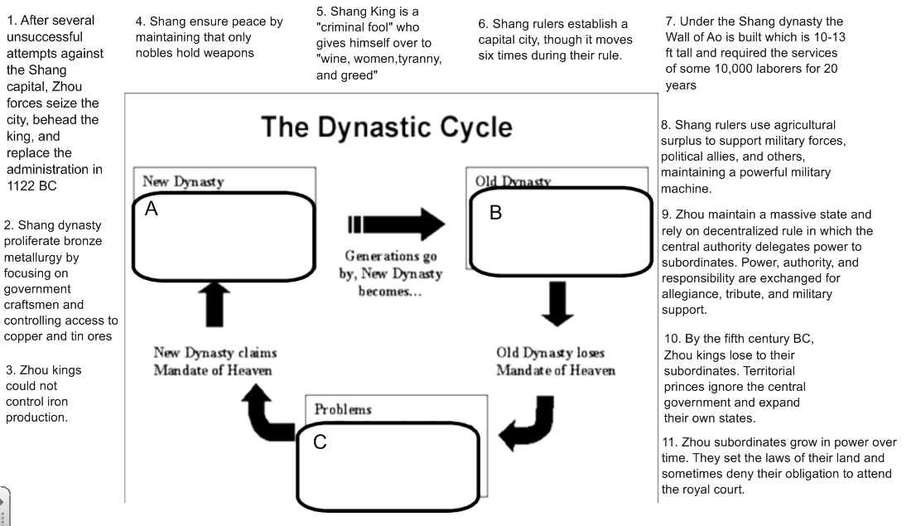
Focus: How did foundational political and military writings influence the Period of the Warring States?
Do now: Review of the Mandate of Heaven - work with your group to place the numbers in the appropriate Dynastic stages on the graph below. (Every number fits best into one box!)
/Strong
/Weak
/Rebellion

Slide 2
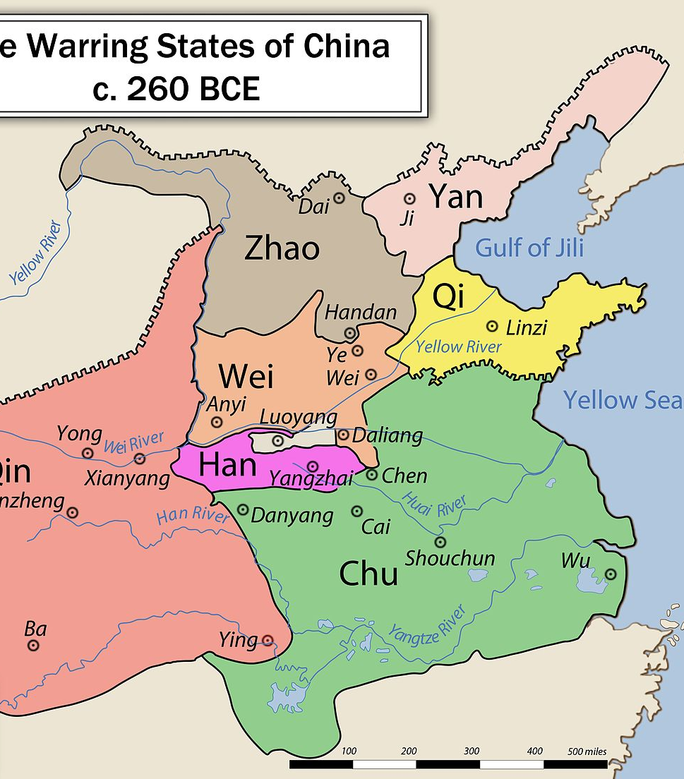
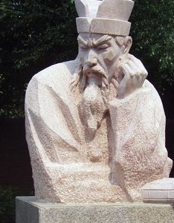
Focus: How did Chinese civilization reflect major periods of stability and instability?
The Warring States Period 475-221 BCE
The decentralized nature of the Zhou Dynasty allowed for states to declare independence from the Zhou Dynasty, and kingdoms fought for territory.
By 334 BC there were 7 warring states: Qin, Chu, Zhao, Wei, Han, Yan, and Qi.
The State of Qin became very powerful under Prime Minister Shang Yang in 359 BCE.
The Prime Minister required that once boys reached 17 and a height of 5 Ft. they had to serve in the military, pay taxes from a share of their crops and help the government through a period of labor.
Young boys were promoted on effort and ability, not by family status, thus giving great incentive for the peasant/soldiers to serve their Prime Minister with great devotion.

Slide 3
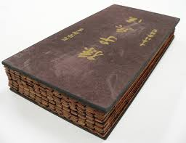
The Art of War by Sunzi Literary Discussion (15 minutes)
Focus: How did foundational political and military writings influence the emergence of the Qin state?
Please take out your preparation for the The Art of War document.
The discussion director should begin the conversation.
All members of the group should be actively listening and participate in the discussion when the appropriate time arises.

Slide 4
The Art of War by Sunzi Literary Discussion (10 minutes)
Focus: How did foundational political and military writings influence the emergence of the Qin state?
10 minute whole class wrap-up discussion.

Slide 5
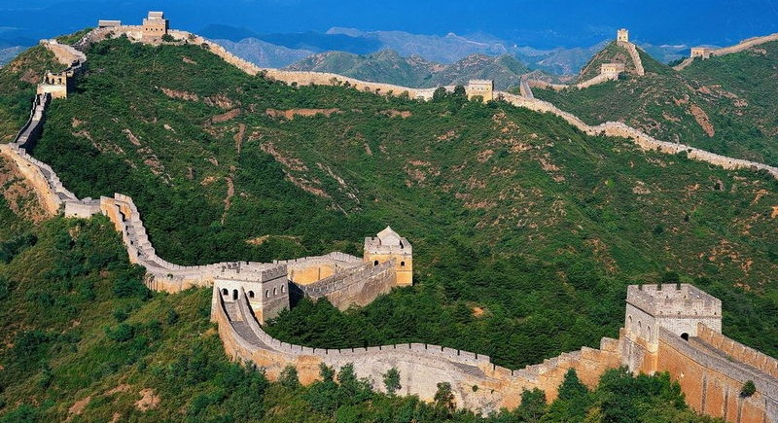
The Great Wall of China
Focus: How did foundational political and military writings influence the emergence of the Qin state?
Summary Question:
How does the presence of the Great Wall of China and the Warring States period represent Chinese attitudes presented in Sun Tzu’s The Art of War?
TIP: Fortifications built by various states during (771-476 BC) and Warring States periods after the fall of the Zhou Dynasty were connected by the first emperor of China, Qin Shi Huang, to protect his newly founded Qin dynasty (221–206 BCE) against incursions by nomads from inner Asia.

